Slide 1
William Stallings
Data and Computer Communications
7th Edition
Chapter 4
Transmission Media

Slide 2
Overview
Characteristics and quality determined by:
  Medium
  Signal
Medium
  Guided - wire
  Unguided - wireless
For Guided Medium
  The medium is more important
For Unguided
  The bandwidth produced by the antenna is more important
Key concerns are data rate and distance

Slide 3
Design Factors
Bandwidth
  Higher bandwidth gives higher data rate
Transmission impairments
  Attenuation
Interference
  Issue especially in case of unguided medium
Number of receivers
  Unicast (one sender, one receiver)
  Multicast (multiple receivers can introduce more errors)

Slide 4
Guided Transmission Media
Twisted Pair
Coaxial Cable
Optical Fiber

Slide 5
Transmission Characteristics of Guided Media
Frequency Range
Typical Attenuation
Typical Delay
Repeater Spacing
Twisted pair (with loading)
0 to 3.5 kHz
0.2 dB/km @ 1 kHz
50 µs/km
2 km
Twisted pairs (multi-pair cables)
0 to 1 MHz
0.7 dB/km @ 1 kHz
50 µs/km
2 km
Coaxial cable
0 to 500 MHz
7 dB/km @ 10 MHz
4 µs/km
1 to 9 km
Optical fiber
186 to 370 THz
0.2 to 0.5 dB/km
5 µs/km
40 km

Slide 6
Twisted Pair

Slide 7
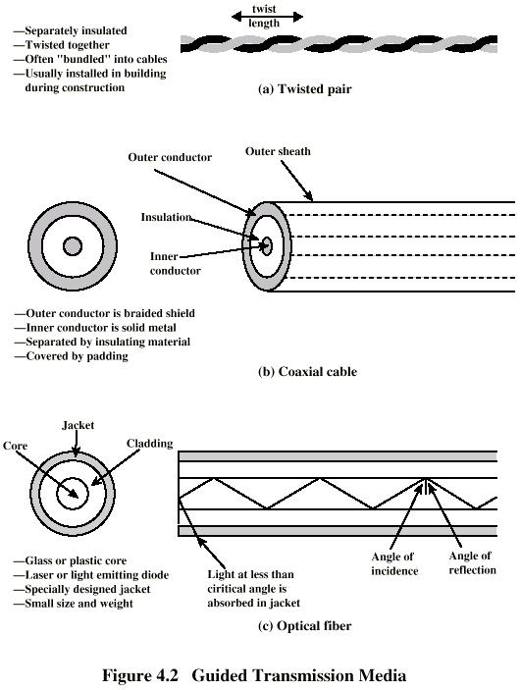
Twisted Pair ➔ Architecture
Two Insulated copper wires
Issues:
(1) Interference due to unwanted electrical coupling of two copper
(2) Interference due to unwanted electrical coupling between the neighboring twisted pairs

Slide 8
Twisted Pair ➔ Applications
Most commonly used medium
Telephone network
  Between house and local exchange (subscriber loop)
Within buildings
  To private branch exchange (PBX)
For local area networks (LAN)
  10Mbps or 100Mbps

Slide 9
Twisted Pair - Pros and Cons
Advantages
  Less expensive
  Easy to work with
Disadvantages
  Low data rate
  Short range

Slide 10
Twisted Pair (TP) ➔Characteristics
Analog transmission
  Amplifiers every 5km to 6km
Digital transmission
  Use either analog or digital signals
  repeater every 2km or 3km
TP is Limited
  Distance
  Bandwidth
  Data rate
Susceptible to interference and noise
  Easy coupling of electromagnetic fields

Slide 11
Unshielded and Shielded TP
Unshielded Twisted Pair (UTP)
  Ordinary telephone wire
  Less expensive
  Weak immunity against noise and interference
  Suffers from external EM interference
Shielded Twisted Pair (STP)
  An extra metallic sheath on each pair
  Relatively more expensive
  Provide better performance than UTP
    Increased Data rate
    Increased Bandwidth

Slide 12
UTP Categories
Cat 3
  up to 16MHz
  Voice grade found in most offices
  Twist length of 7.5 cm to 10 cm
Cat 4
  up to 20 MHz
Cat 5
  up to 100MHz
  Commonly pre-installed in new office buildings
  Twist length 0.6 cm to 0.85 cm
Cat 5E (Enhanced) –see tables
Cat 6
Cat 7

Slide 13
Coaxial Cable

Slide 14
Coaxial Cable ➔ Architecture

Slide 15
Coaxial Cable ➔Applications
Television (TV) signals distribution
  Ariel to TV
  Cable TV
Long distance telephone transmission
  Can carry 10,000 voice calls simultaneously
  Being replaced by fiber optic
Short distance computer systems links
  Local area networks (LAN)
  Metropolitan area network (MAN)

Slide 16
Coaxial Cable ➔Characteristics
Analog
  Amplifiers every few km
  Closer if higher frequency
  Up to 500MHz
Digital
  Repeater every 1km
  Closer for higher data rates
Problem
  Inter-modulation noise
  Thermal noise

Slide 17
Optical Fiber

Slide 18
Optical Fiber ➔ Architecture

Slide 19
Optical Fiber ➔ Benefits
Greater capacity
  Data rates of hundreds of Gbps
Smaller size & weight
  Made up of extremely thin fibers
Lower attenuation
  Electromagnetic isolation
Greater repeater spacing
  10s of km at least

Slide 20
Optical Fiber - Transmission Characteristics
Operational range
  10¹⁴ to 10¹⁵ Hz
Light source
  Light Emitting Diode (LED)
    Cheaper
    Wider operating temperature range
    Last longer
  Injection Laser Diode (ILD)
    Operates on laser principle
    More efficient
    Greater data rate
Wavelength Division Multiplexing (WDM)

Slide 21
Wireless Transmission

Slide 22
Wireless Transmission Frequencies
2GHz to 40GHz (Microwave Frequency)
  Highly directional
  Point to point devices
  Microwave communications
30MHz to 1GHz (Radio Frequency)
  Omnidirectional
  Broadcast radio
3 x 10¹¹ to 2 x 10^{14 (Local Frequency)}
  For Local applications

Slide 23
Antennas
By definition
  Is a electrical device
Transmission
  Radio frequency energy from transmitter
  Converted to electromagnetic energy
  By antenna
  Radiated into surrounding environment
Reception
  Electromagnetic energy impinging on antenna
  Converted to radio frequency electrical energy
  Fed to receiver
Same antenna often used for both

Slide 24
Radiation Pattern
Antenna might radiate power in all direction
Not same performance in all directions
How can we determine the performance of an antenna?
  Solution is “Radiation Pattern”
    Graphical representation of the radiated power
Isotropic antenna is an ideal antenna
  Radiates in all directions equally
  Use as a reference to characterize the power

Slide 25
Antenna Gain
Measure of directionality of antenna
Power output in particular direction compared with that produced by isotropic antenna
Measured in decibels (dB)
Gain could be +ve or -ve

Slide 26
Terrestrial Microwave (TMW)
Parabolic antenna
Small beam
Line of sight
Use especially for P2P applications
Usually use for long distance communications

Slide 27
Satellite Microwave (SM)
Satellite is relay station
Satellite
  receives on one frequency
  amplifies or repeats signal
  transmits on another frequency
Requires geo-stationary orbit
  Height of 35,784km
Applications
  Television
  Long distance telephone
  Private business networks

Slide 28
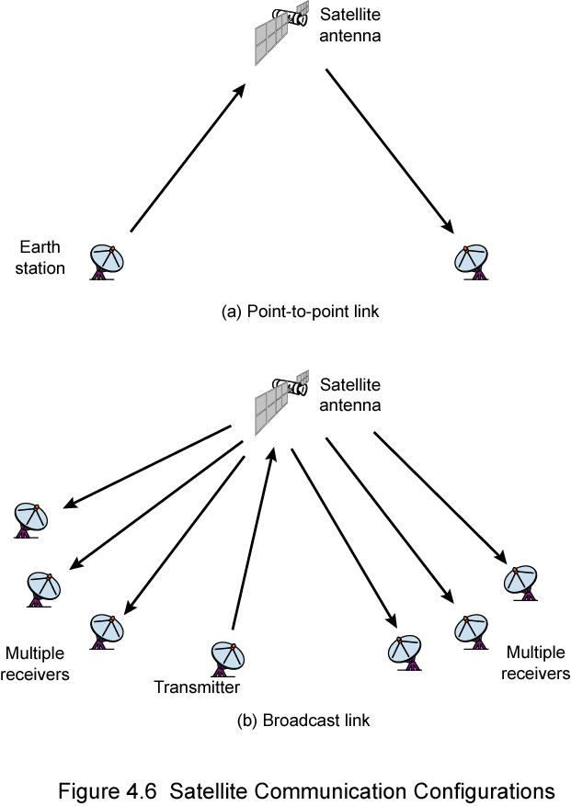
Satellite Point to Point Link
ground based microwave receiver
ground based microwave transmitter

Slide 29
Satellite Broadcast Link
Is it really broadcast??

Slide 30
Broadcast Radio
Omnidirectional (travel in all directions)
Line of sight is over
Doesn’t need parabolic antenna
Example→ FM radio

Slide 31
Wireless Propagation
Signal travels along three routes
  Ground wave
    Follows contour of earth
    Up to 2MHz
    AM radio
  Sky wave
    Signal reflected from ionize layer of upper atmosphere
    BBC world service, Voice of America
  Line of sight
    Above 30Mhz
    Antennas must be physically aligned
    Atmosphere can reflect the microwave signal

Slide 32
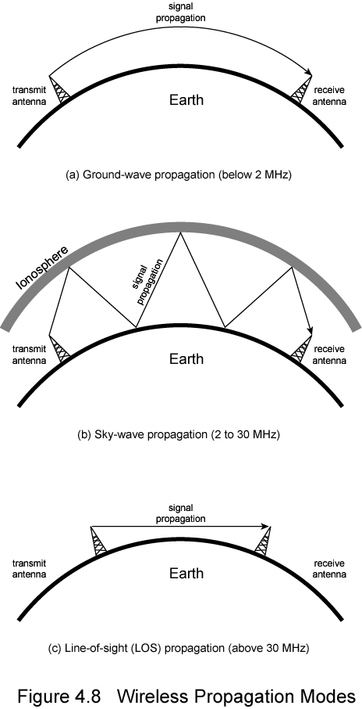
Sky Wave Propagation
Notes:
This is just a pictorial description of the SKY wave communication ….

Slide 33
Ground Wave Propagation
Notes:
This is just a pictorial description of the Ground wave communication ….

Slide 34
Line of Sight Propagation

Slide 35
Transmission Impairments in Wireless Transmission
Free Space Loss
  Signal dispersion is a function of distance
  Ratio between power-radiated to power-received
  Greater for lower wavelength
  Antenna gain can be used to compensate the losses
  Also known as near far problem
Refraction
  Each wireless medium has its own density
  Propagation speed is a function of density of the medium
  When medium changes, the result is refraction
  Refraction means change of direction

Slide 36
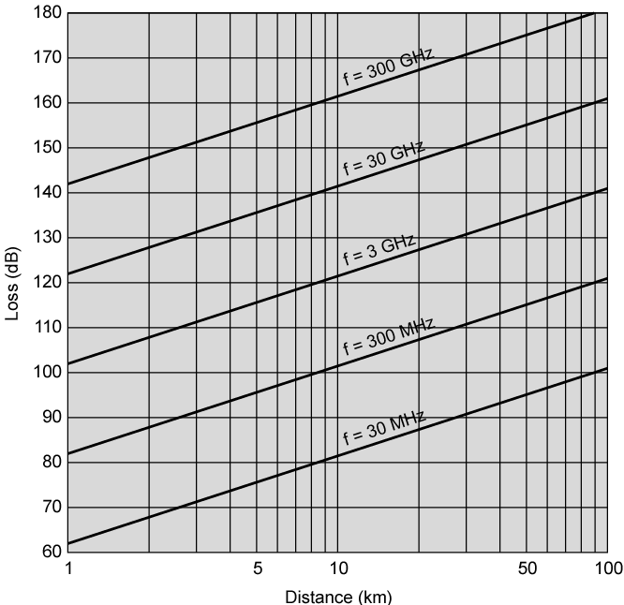
Free
Space
Loss

Slide 37
Required Reading
Review Examples 4.1 to 4.4
HW#2: Problems 4.1 and 4.2
  Due Date: Tuesday, September 25 (in class timing)
  Need hard copy (typed or in hand writing)
OpNet Lab 2 and 3
  (Due Date: Thursday, September 27 before 2:30 Pm)
  3 Students (maximum) per group
  One submission per group

